Slide 1
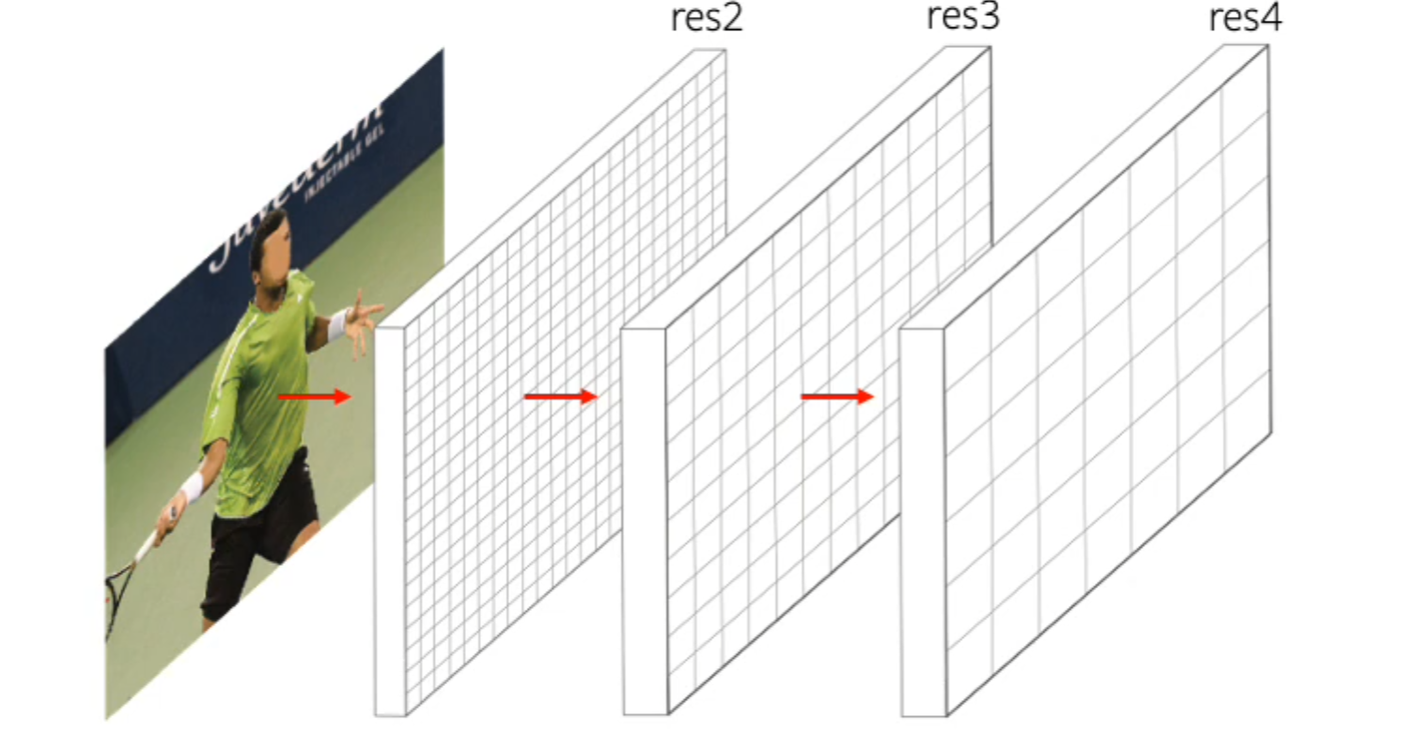
PointRend Image Segmentation as Rendering
Su Hyung Choi
Korea University
Research Intern @ Computer Vision Lab
Submitted on Jan 11, 2022
Authors: Facebook AI Research (FAIR)
Alexander Kirillov, Yuxin Wu, Kaiming He Ross Girshick

Slide 2
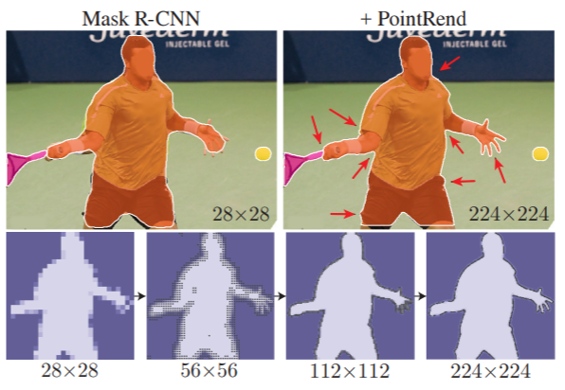
Typical Problems in Image Segmentation
CNNs for image segmentation typically operate on regular 3 channel grids.
Not computationally ideal for image segmentation.
Label maps predicted by these networks are mostly smooth.
Unnecessarily oversample the smooth areas while simultaneously under-sampling object boundaries.
The result is excess computation in smooth regions and blurry contours.
Often predict labels on a low-resolution regular grid.

Slide 3
PointRend
Propose “Point based Rendering” as a methodology
for image segmentation using point representations.
To Efficiently “render” high quality label map
Benefits over other architectures:
Training and Inference is less computationally intensive
Generate higher quality, higher resolution label maps (masks)

Slide 4
CNN/FCN is the main tool for 2D image recognition
Operates with feature map on regular grids

Slide 5
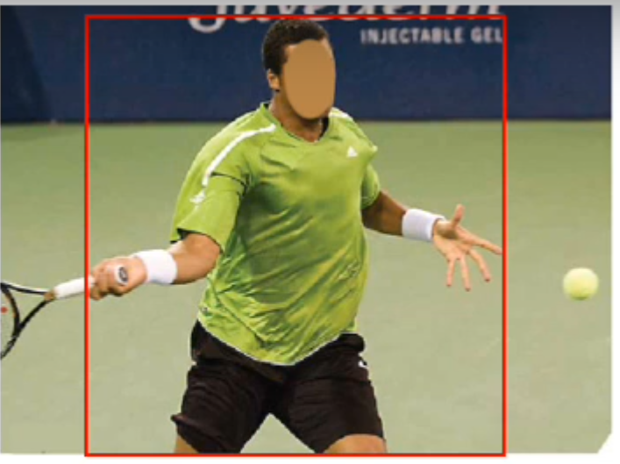
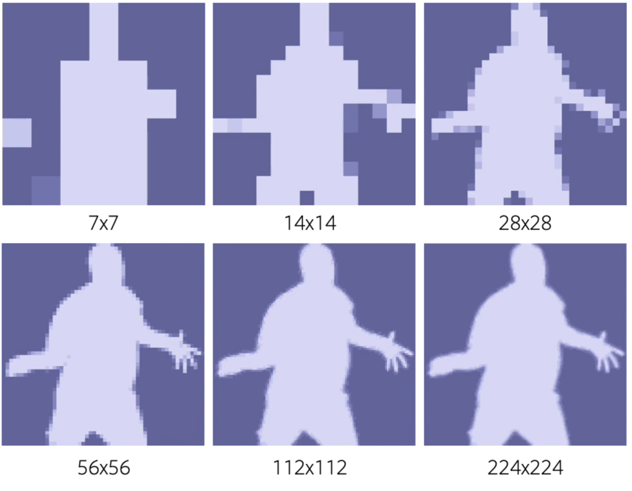
Output resolution is tradeoff between computational cost and level of detail

Slide 6
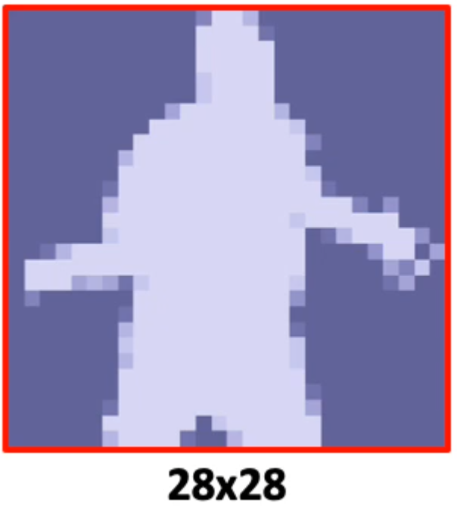
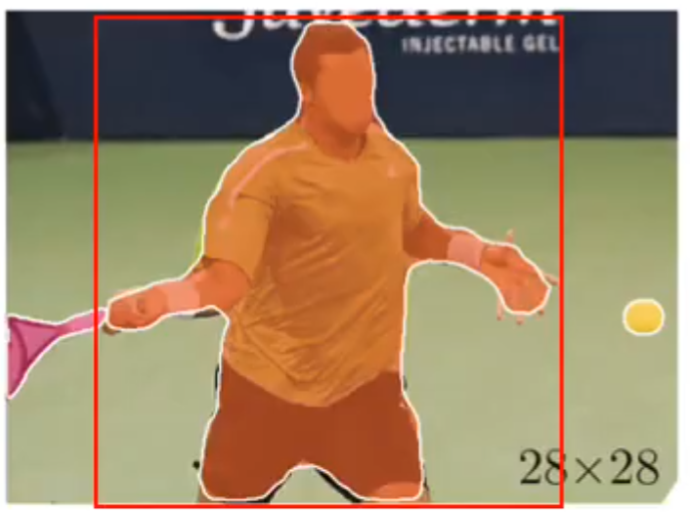
Mask R-CNN efficiently predicts
low-resolution masks

Slide 7
Note that different areas require
different levels of detail

Slide 8
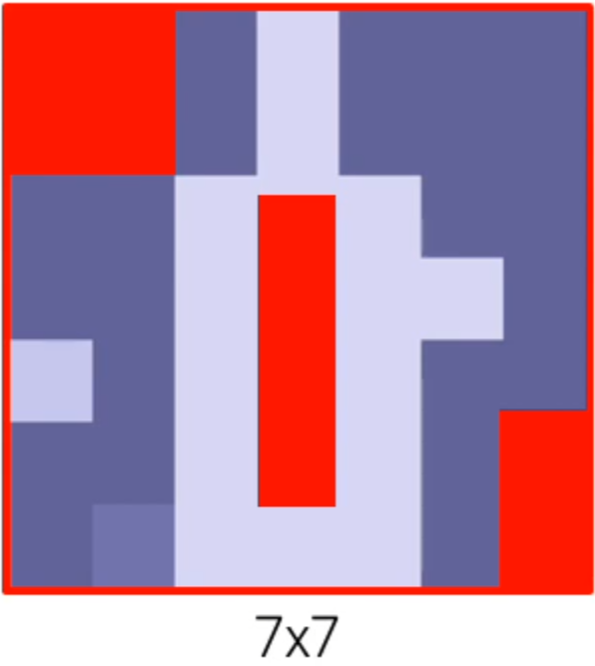
Some are perfectly segmented with low resolution prediction

Slide 9
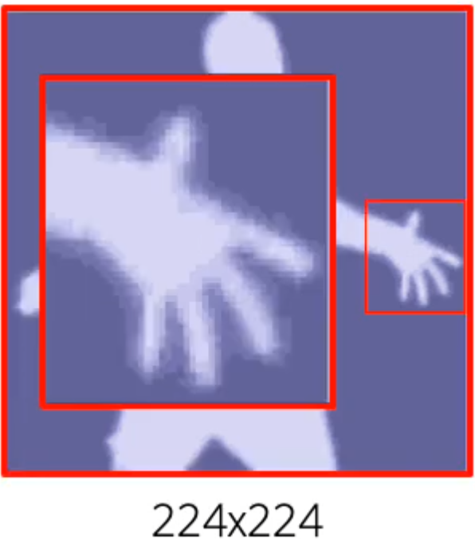
Whereas high-frequency regions require prediction in a very high resolution

Slide 10
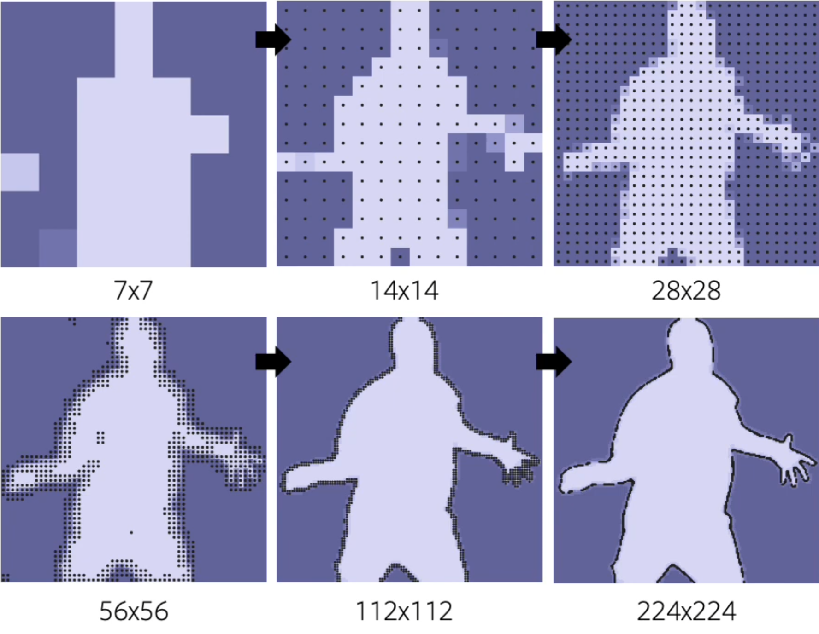
PointRend gradually increases
resolution by making predictions
for the most uncertain points

Slide 11
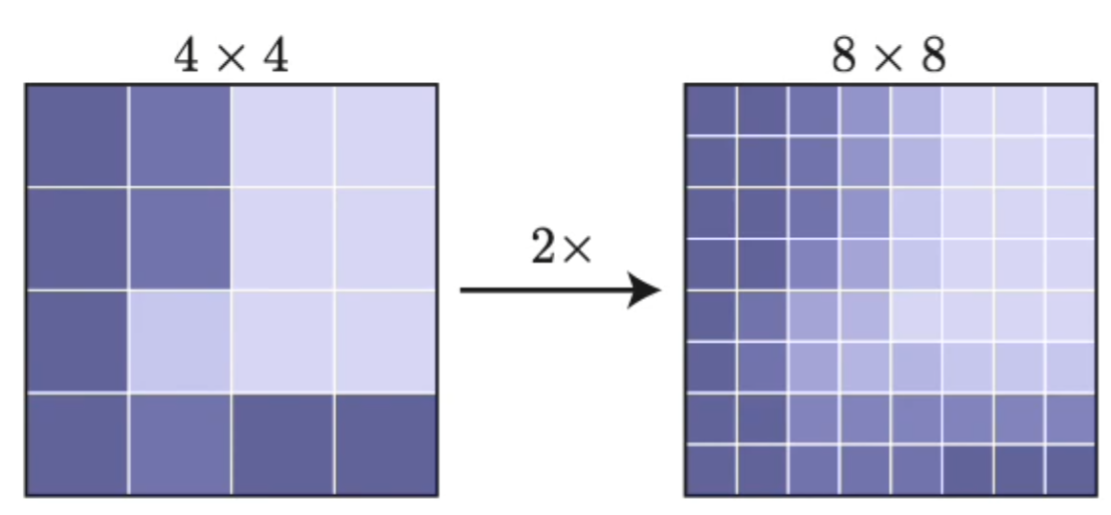
Point-based inference via subdivision
Lower resolutions prediction is unsampled with bilinear interpolation

Slide 12
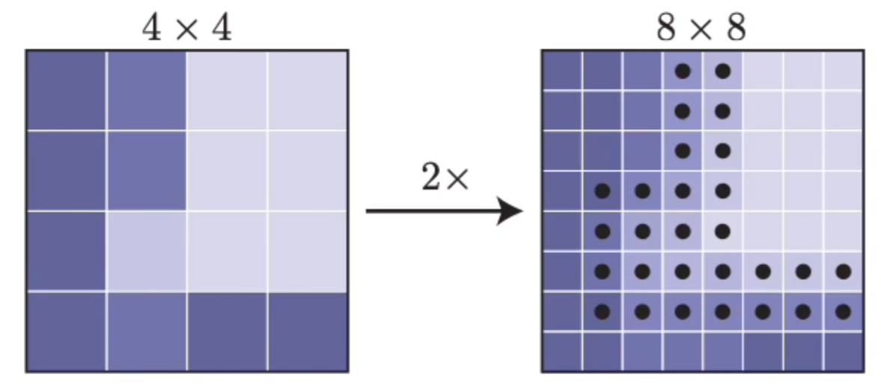
Point-based inference via subdivision
The subset of most uncertain
points is selected

Slide 13
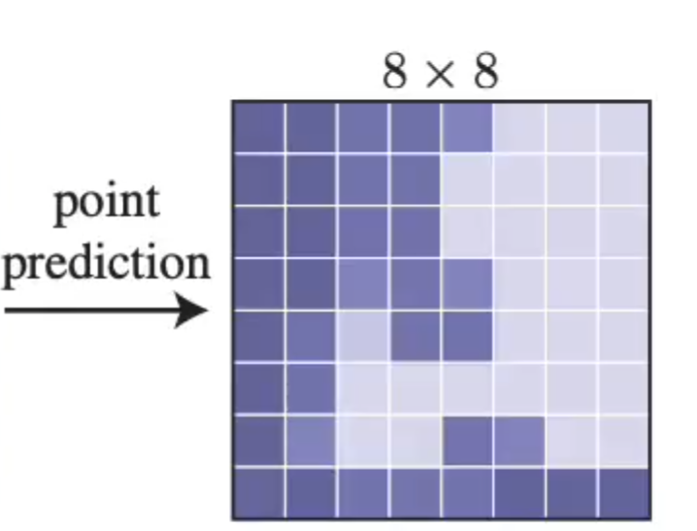
Point-based inference via subdivision
Prediction for each selected points is refined using a lightweight MLP

Slide 14
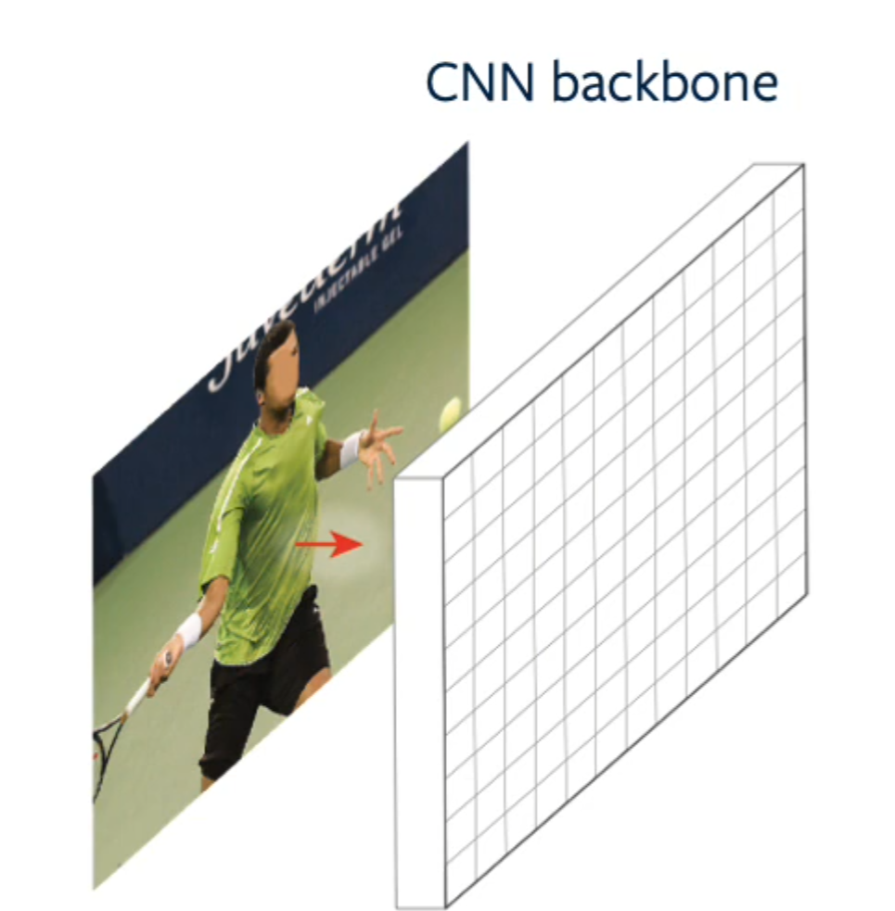
PointRend architecture for instance segmentation
Backbone computes features that represent the whole image

Slide 15
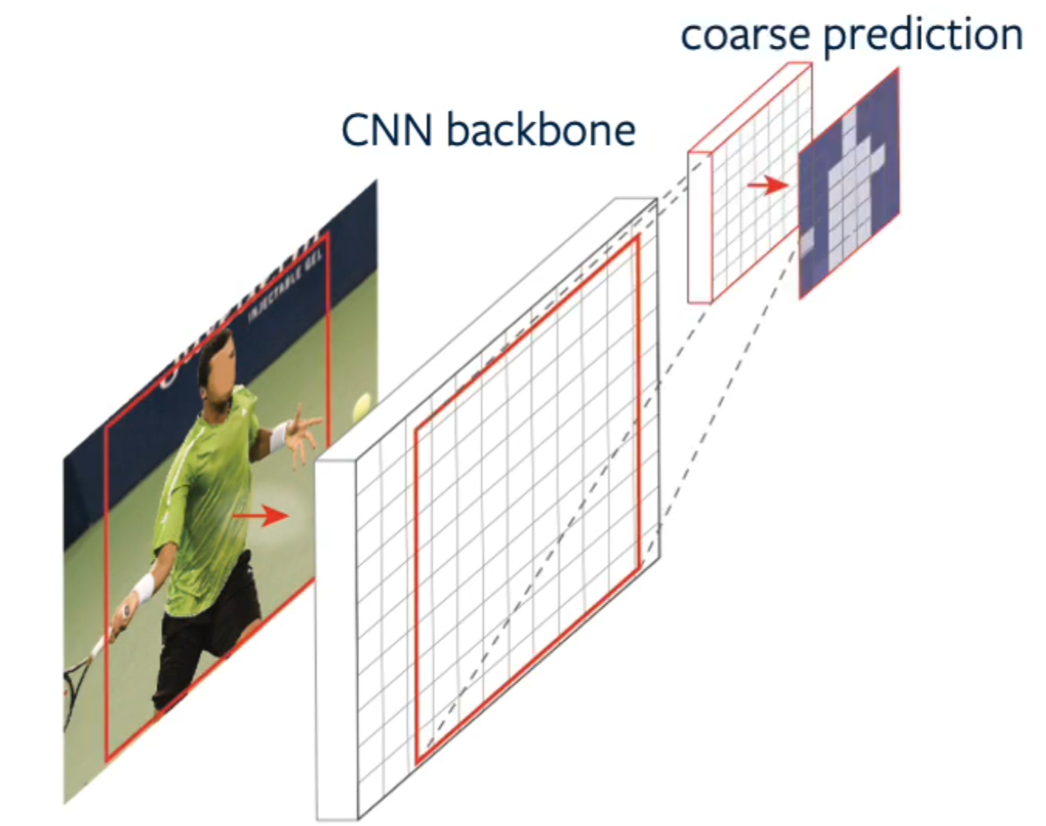
PointRend architecture for instance segmentation
For each bounding box
a small head yields
low-resolution mask prediction

Slide 16
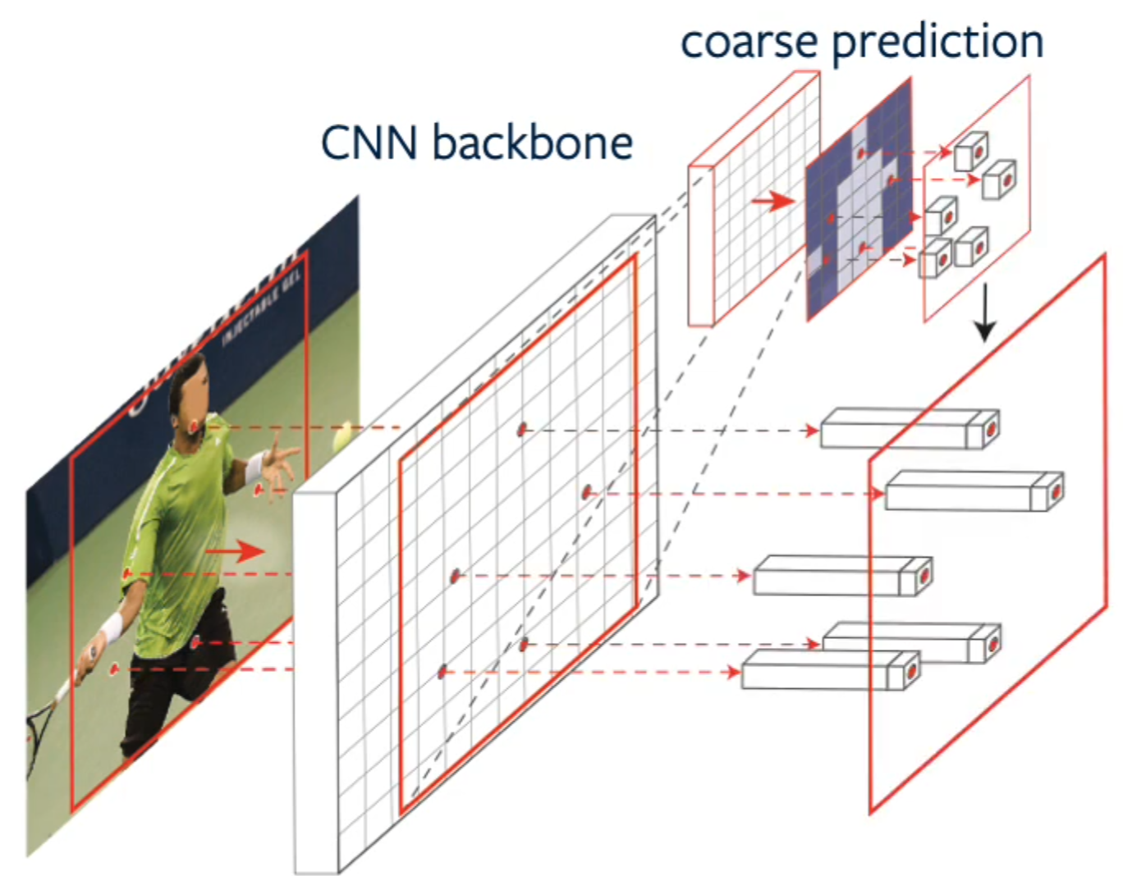
PointRend architecture for instance segmentation
For a subset of points we extract features from the coarse prediction and the backbone features using bilinear interpolation

Slide 17
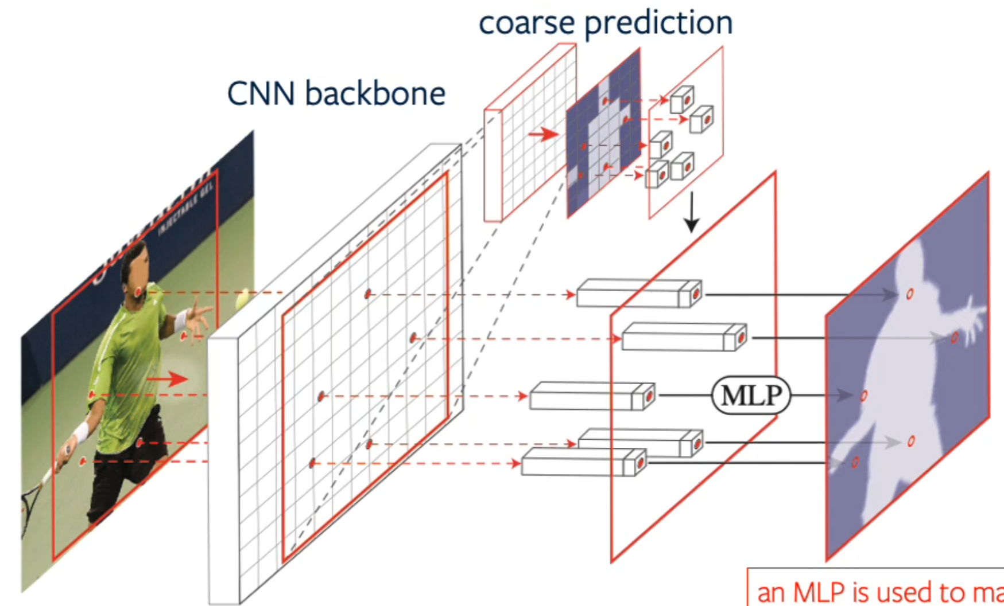
PointRend architecture for instance segmentation
An MLP is used to make prediction for each point independently

Slide 18
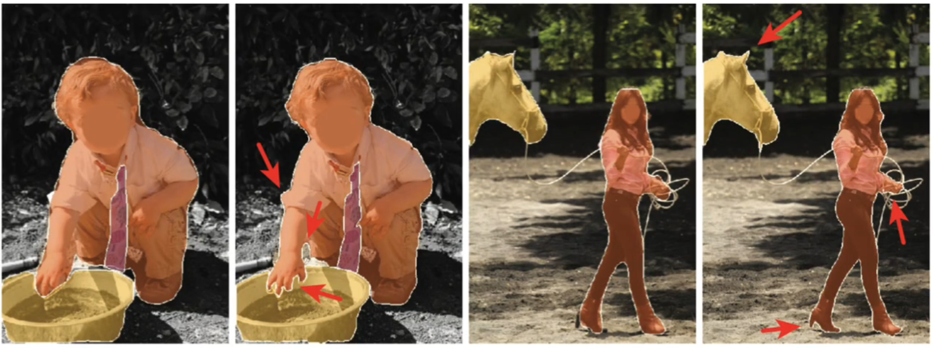
Mask R-CNN with standard head vs. Mask R-CNN with PointRend
+ PointRend
+ PointRend

Slide 19
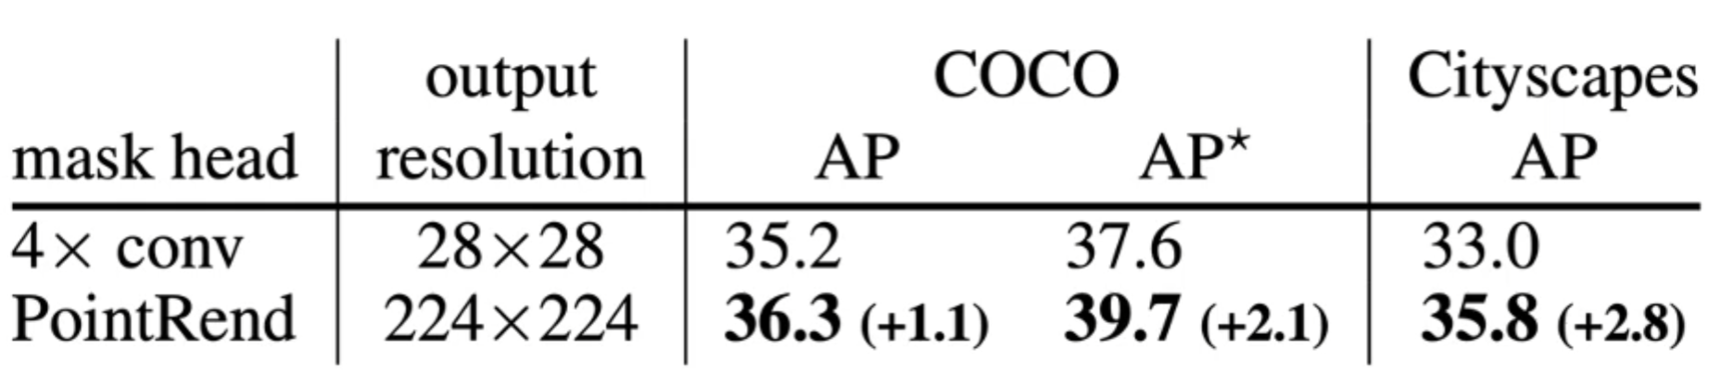
Quantitative comparison: instance segmentation
Mask R-CNN with standard head (4x Conv) vs. Mask R-CNN with PointRend
AP* is COCO mask AP for a COCO-trained model
evaluated against the higher quality LVIS annotation

Slide 20
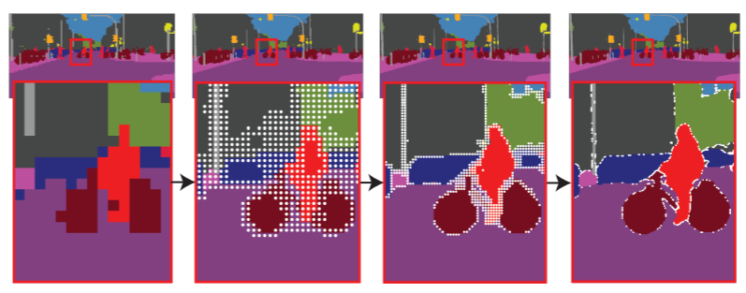
PointRend for semantic segmentation
PointRend can be applied on top of
any modern semantic segmentation model

Slide 21
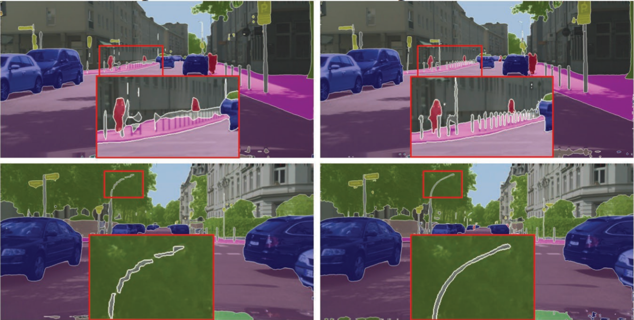
Deeplab V3 vs. Deeplab V3 + PointRend
+ PointRend

Slide 22
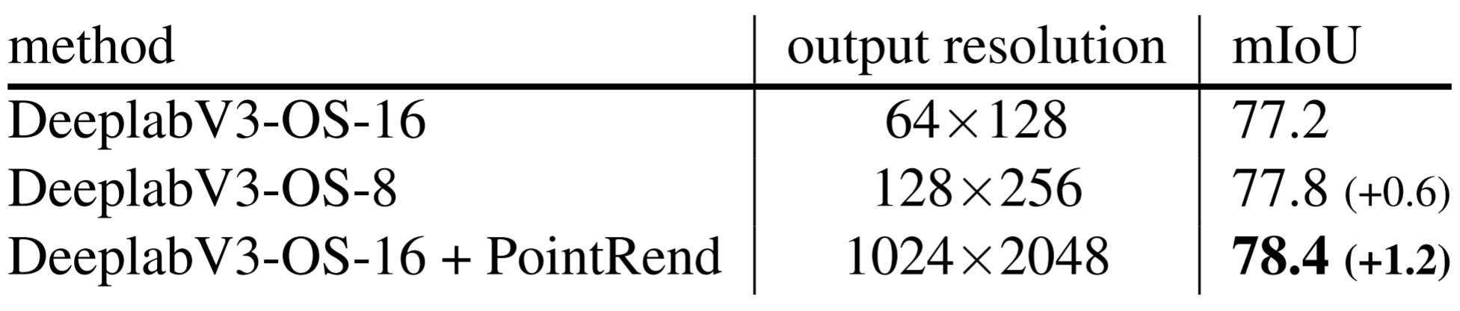
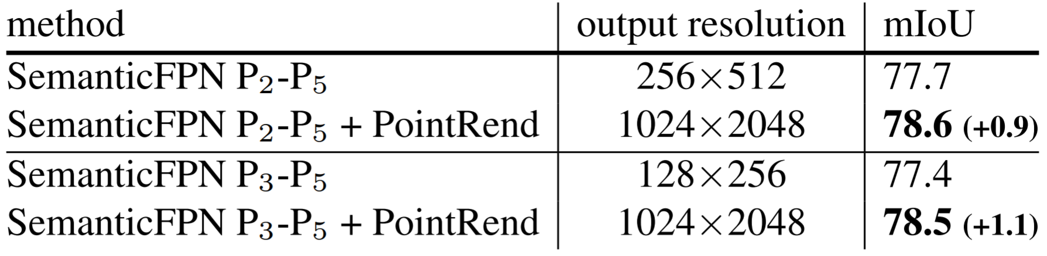
Quantitative comparison: semantic segmentation
DeeplabV3 vs. DeeplabV3 with PointRend
SemanticFPN vs SemanticFPN with PointRend

Slide 23
Conclusion
High resolution output with little to no computational overhead
Higher resolution, more accurate masks
with fewer model params, less compute time.
“plug & play” on top of any FCN-based model for segmentation
Significant quantitative and qualitative improvement

Slide 24
Thank You.
[Paper Review] PointRend: Image Segmentation as Rendering
Su Hyung Choi

